Slide 1
Deep Lerning 2
Object Detection
Bruno Berger
Matr Nr 2170706
Interaktionstechnik und Design

Slide 2
Introduction - Task
Detect common Objects
Save the coordinates and timestamp
of the object
Visualise the detections on a map

Slide 3
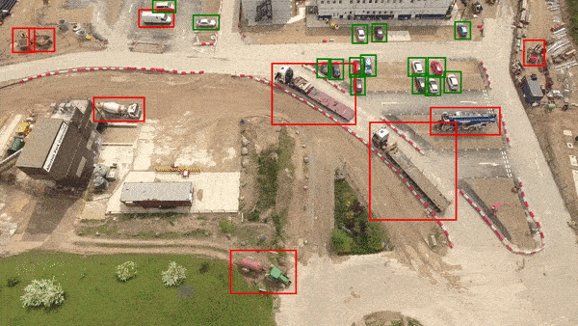
Possible Usages
Improve autonomous driving
  → “What will I encounter there?”
Cartography, e.g. with drone footage:
  Mapping livestock movement
  Distribution of objects
https://medium.com/nanonets/how-we-flew-a-drone-to-monitor-construction-projects-in-africa-using-deep-learning-b792f5c9c471

Slide 4

Set parameters
Online Semester → no hardware implementation
→ no real GPS data
Use git for version-control
  GitHub-Wiki for deliveries
  GitHub Project-Board to keep track of tasks

Slide 5
Research
Blogs by Adrian Rosebrock on PyImageSearch.com
  Computer-vision using the Python package OpenCV
  Already helped with Blink-Detection
Similar Projects often use Street-view images
  Still often applicable to this project

Slide 6
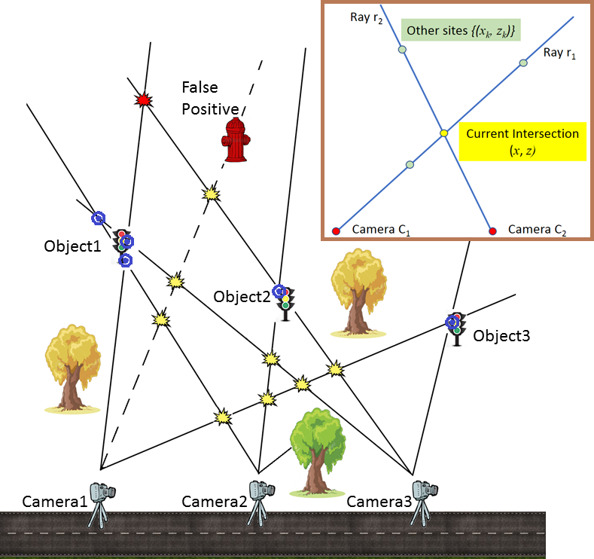
Research – Related Works
Research from Dublin:
Images from Google Street View
Detecting same object from multiple angles
Using depth-information from camera
→ Very exact position

Slide 7
Research – Object Detection
The detectors YOLO and MobileNetSSD were considered for this project
  Both used in the blog post of Adrian Rosebrock
General Object Detection Sequence:
  Extract “regions of interest”/”Bounding Boxes” from image
  Run these through a classifier
→ Image has to be resampled twice → slow

Slide 8
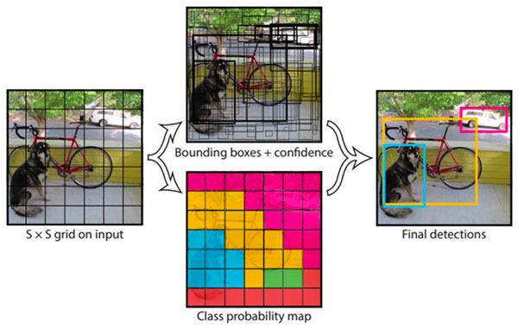
Research – Object Detection - YOLO
“You Only Look Once” → One-Stage Detector
Much faster than R-CNN
Lower accuracy

Slide 9
Research – Object Detection - MobileNetSSD
SSD - “Single Shot Detector”
Faster and more accurate than YOLO
“MobileNetSSD” is SSD on a different DL framework
  Used for Mobile devices → better speed, less accuracy

Slide 10

Concept
OpenCV package → use Python
Make YOLO and MobileNetSSD selectable
Something like “leaflet” for visualisation
Simple random numbers for GPS

Slide 11
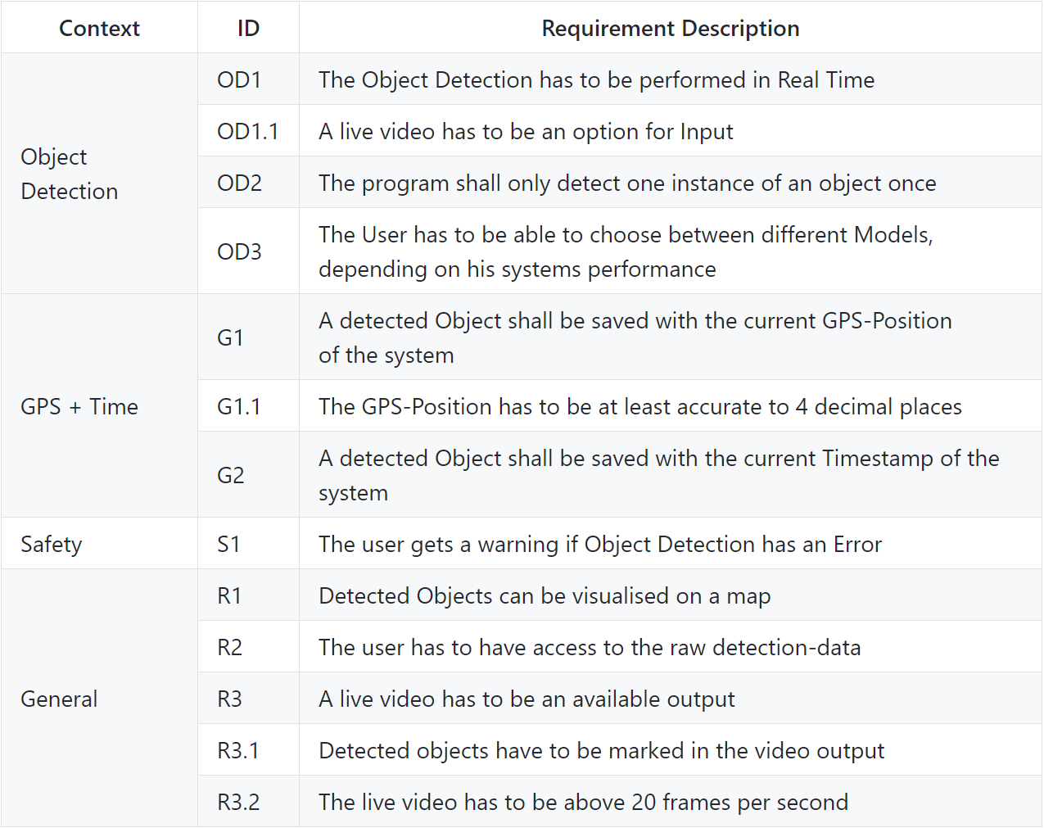
Concept - Requirements

Slide 12
Implementation – Object Detection
YOLOv3 ↔ MobileNetSSD:
Require slightly different code
  Different DL-framework
  Not combinable
Resulted in unnecessary complicated code
→ Only use MobileNetSSD (+ branch for old Version)
  Way better performance
  Smaller size

Slide 13
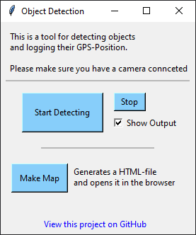
Implementation – UI
Build with Tkinter package
Central hub for the user
  Start/Stop Object Detection
  Live-toggle video-output
  Generate and show map

Slide 14
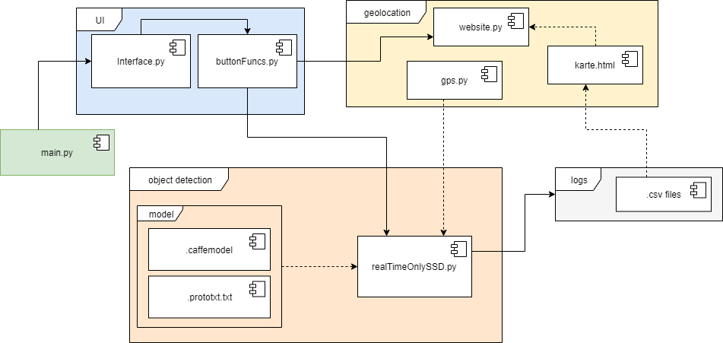
Implementation – General Structure

Slide 15
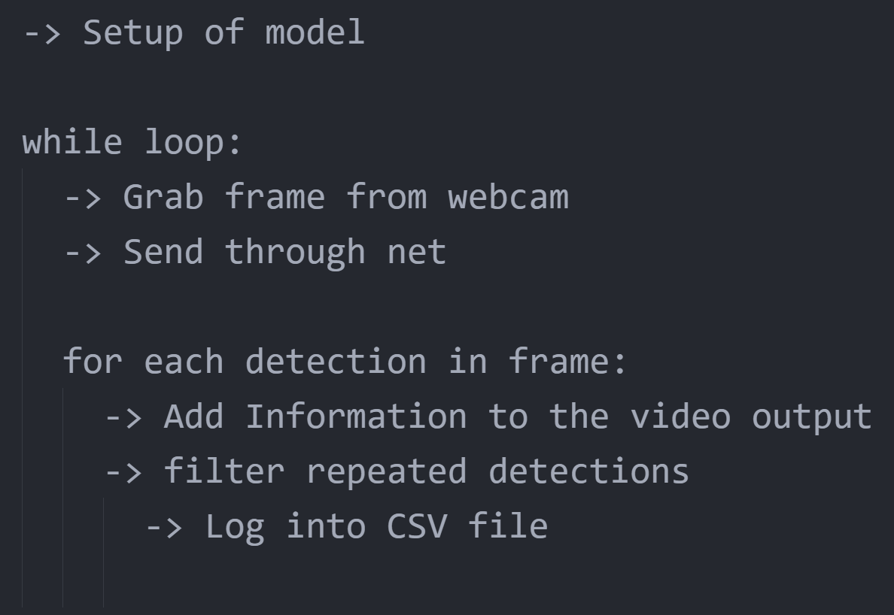
Implementation – Object Detection

Slide 16
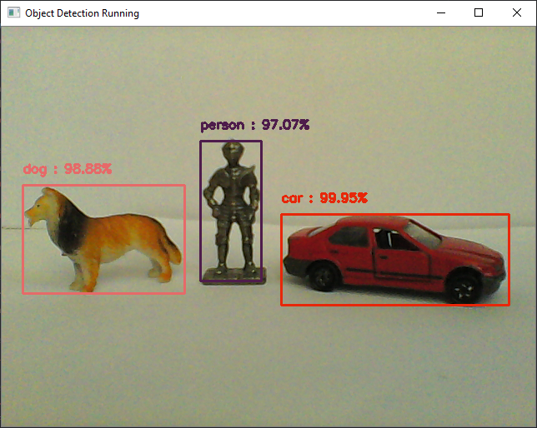
Implementation – Object Detection

Slide 17
Implementation - Filter
Goal → Detect the same object only once
Buffer-list with every object detected
Save information about each detection
  Name, timestamp, position in frame
Compare new detection to all old ones
  Calculate difference of time and position
→ New enough? → save into CSV file

Slide 18
Implementation – Visualisation
folium package for mapping
Makes leaflet usable in Python
File-dialog to chose session
Each detection in the CSV file creates a “marker”

Slide 19
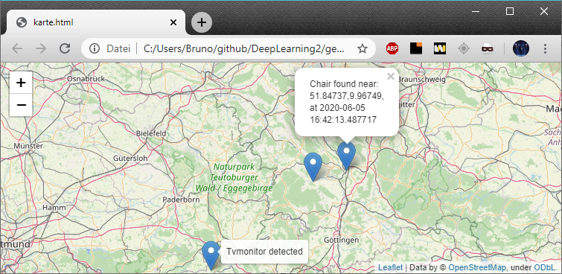
Implementation – Visualisation

Slide 20
Conclusion - Results
→ Don’t word reqs. like that

Slide 21
Conclusion – Future Work
Bring system onto mobile hardware (smartphone/
microcontroller)
  → Real GPS-data → better Filter
More detailed map-markers
  Even pictures of the objects maybe
Run the OD with a GPU
  Much better performance
  System not mobile

Slide 22
Unaswered Questions?

Slide 23
(Live Presentation of implementation)

